Slide 1
Artificial Intelligence
Deep Q Network (DQN)

Slide 2
Outline
Introduction
Deep Q Network
Sample Code
Performance
Assignment 3
Submission
Grading

Slide 3
Introduction

Slide 4
Introduction
Why deep Q network?
For the previous task, we discretize 2 features to buckets and store in a Q-table
But for complicated tasks, their features may more than hundreds or thousands
It’s impossible to discretize all of them and create a Q-table
How to solve it?
Use deep Q network to predict the best action for input a state

Slide 5
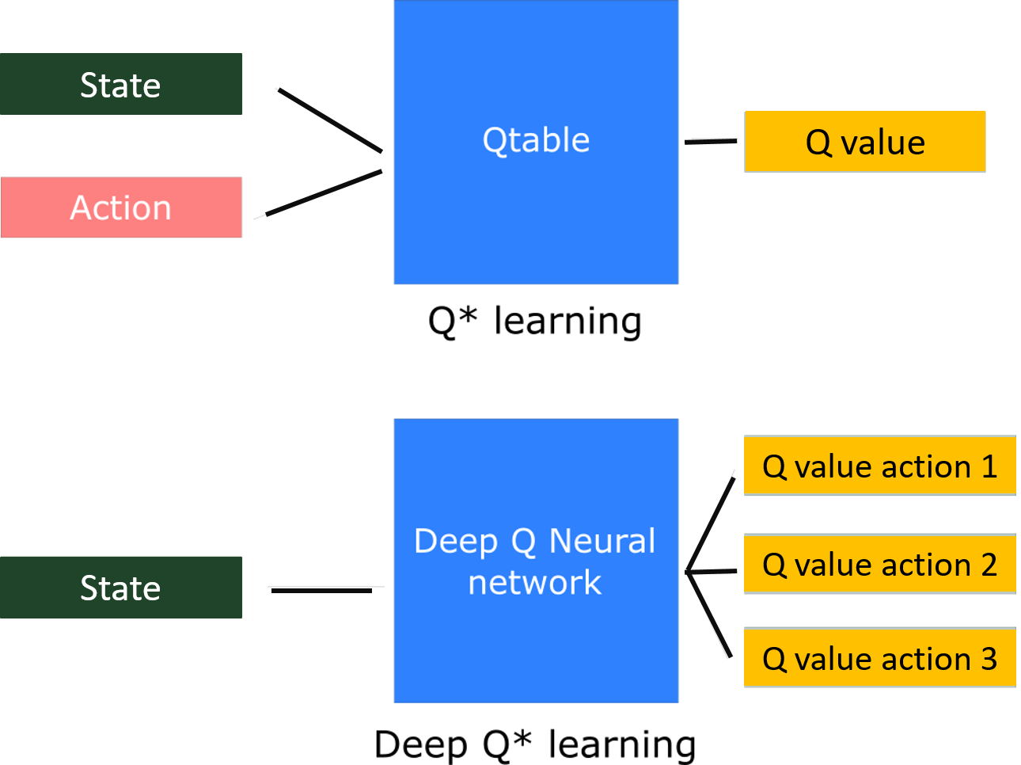

Slide 7
Deep Q Network (DQN)

Slide 8
Deep Q Network (DQN)
The structure is similar with Q-learning, but DQN ...
Choose action by neural network instead of Q-table
Add experience replay mechanism to train the neural network
2 neural networks are required: evaluation model & target model
Flowchart of DQN
See the next slide

Slide 9
START -->

Slide 10
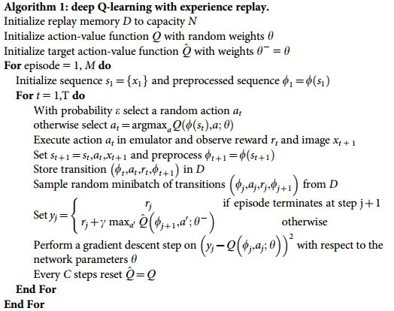

Slide 11
Sample Code

Slide 12
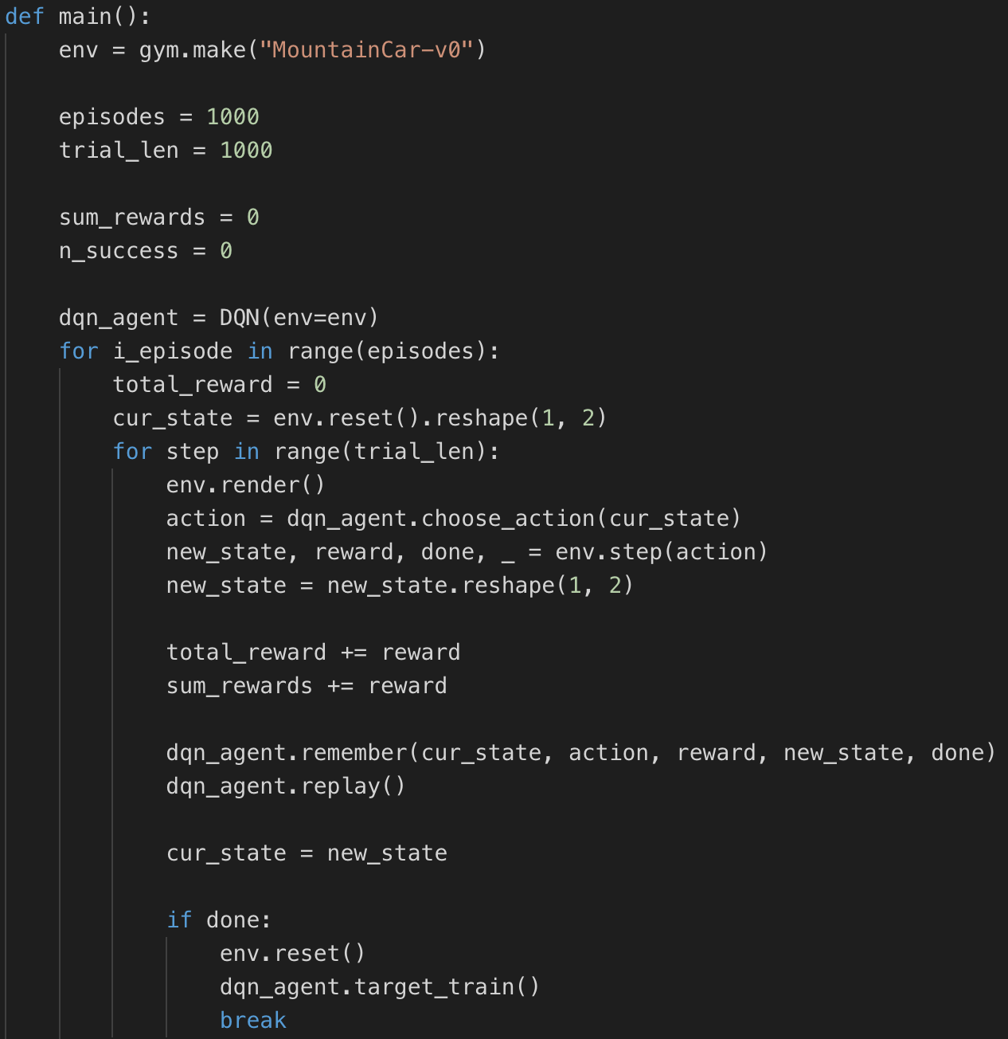
Sample Code
Part 1: Define the network
Part 2: Choose action
Part 3: Experience Replay
& Train evaluation model
Part 4: Train target model

Slide 13
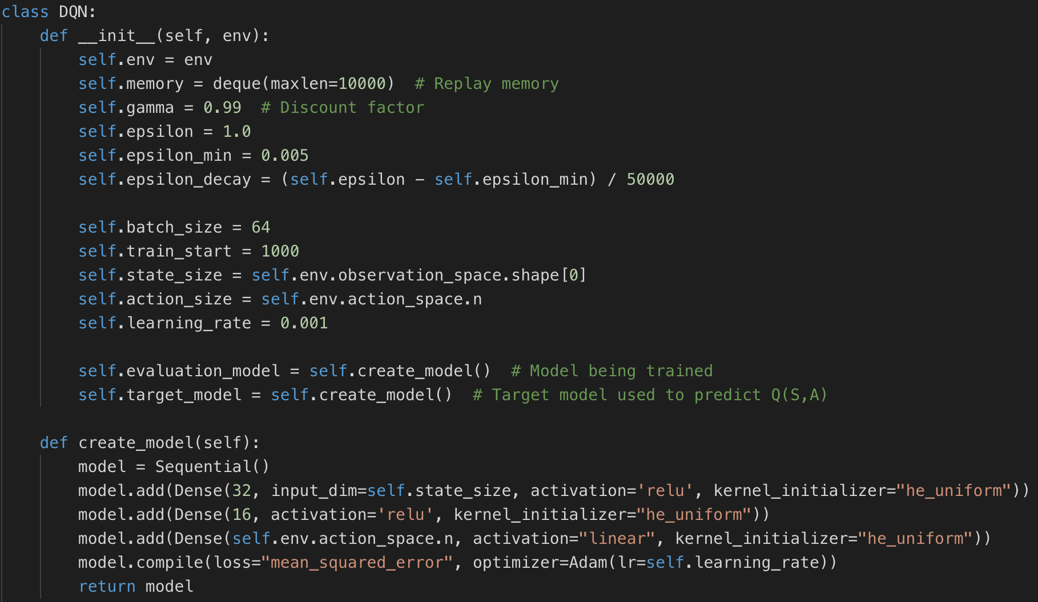
Part 1: Define the network

Slide 14
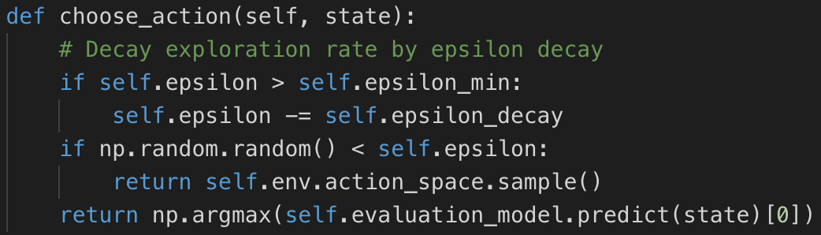
Part 2: Choose action
Basically same as Q-learning
But decide the action by input current state to evaluation_model

Slide 15
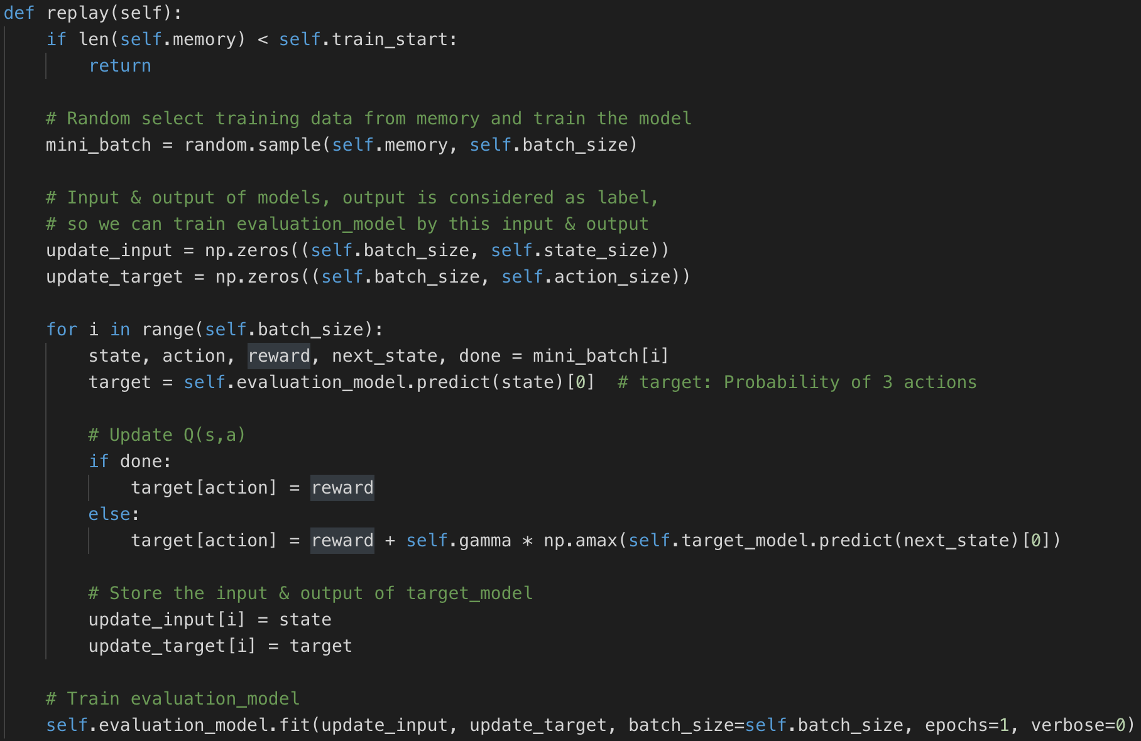
Part 3: Experience Replay

Slide 16
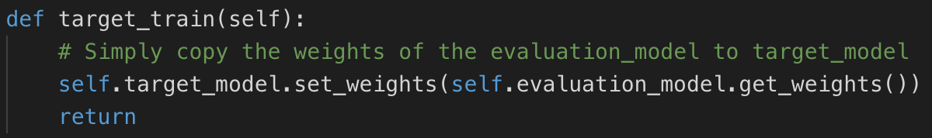
Part 4: Train target model
Simply copy the weights of the evaluation_model to target_model

Slide 17
Performance
MountainCar-v0

Slide 18
Performance of MountainCar-v0

Slide 19
Assignment 3

Slide 20
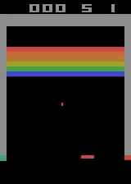
Assignment 3
Atari Game: Breakout-ram-v0
Observation: the RAM of the Atari machine, consisting of 128 bytes (128 features)
Action: Discrete(4)
Train a DQN model to maximum the score of playing the breakout game.
Number | 0 | 1 | 2 | 3
Action Meaning | NOOP | FIRE | RIGHT | LEFT

Slide 21
Reference Baseline
Average reward of last 100 episodes
Examples
X axis = 100
avg reward of 0~100 episode
X axis = 4800
avg reward of 4700~4800 episode

Slide 22
Reference Baseline (cont.)
Training Environment
CPU: i5-6360U 2.0GHz (no GPU)
RAM: 16GB (cost less than 1GB while training)
Training time for 5,000 episodes: 8.5 hours
Parameters Setting
Experience replay every 4 steps
Update target model every 2500 steps
(If you apply experience replay & update target model every step, it will take you very long time to train)

Slide 23
Submission
Source code of DQN
Implement breakout DQN in Python3
Report (102030405_report.docx)
Describe your DQN model (20%)
What is the average time to train an episode? (5%)
Plot the learning curve to show the performance (5%) (Please refer to page 21)
X-axis: 1000 episodes 5000 episodes
Y-axis: average reward
Deadline: 1/10 (Thu) 23:59
NO LATE SUBMISSION!! NO LATE SUBMISSION!! NO LATE SUBMISSION!!

Slide 24
Grading
TA class (10%)
Report (30%)
Performance (60%)

Slide 25
Materials
RL & DQN tutorial video in tensorflow (Chinese, English)
RL & DQN tutorial (link)
Asynchronous Deep Q-Learning for Breakout with RAM inputs (link)

Slide 26
Materials
GitHub
AdrianHsu/breakout-Deep-Q-Network (link)
floodsung/DQN-Atari-Tensorflow (link)
MorvanZhou/Reinforcement-learning-with-tensorflow/DQN (link)
Paper
Asynchronous Deep Q-Learning for Breakout with RAM inputs (link)

